Slide 1
Notes:
Test from web

Slide 2
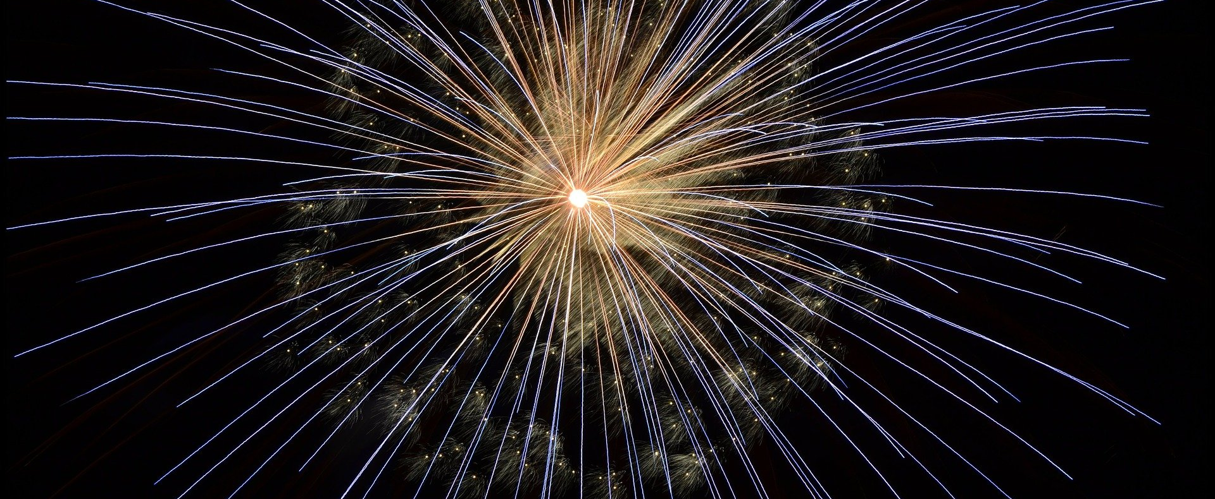
Picture the Scene…
Notes:
Shiny new feature to add to your code
Users will be SUPER happy

Slide 3
Picture the Scene…
Notes:
The code wasn’t designed to do this
Tests are passing, but you're struggling to get the code to do what you need.
You think you can see a way...
Maybe the code won't compile for half an hour whilst you bend it to your will...
And maybe your code reviewers won't complain about the size of the change, taking them hours to review?
And if you're lucky and concentrate very hard, it will be OK. Won't it?

Slide 4
Picture the Scene…
Notes:
Danger is about not getting to success – you end throwing away a large batch of work.
Either entirely successful, or entirely wasted.
It’s a big risk

Slide 5
Picture the Scene…
Notes:
This talk will show you techniques to be kind to yourself - and your team
A way where every small step makes your code better, permanently – and none of your work is wasted.

Slide 6
Refactoring Superpowers
Clare Macrae – ACCU 2021

Slide 7
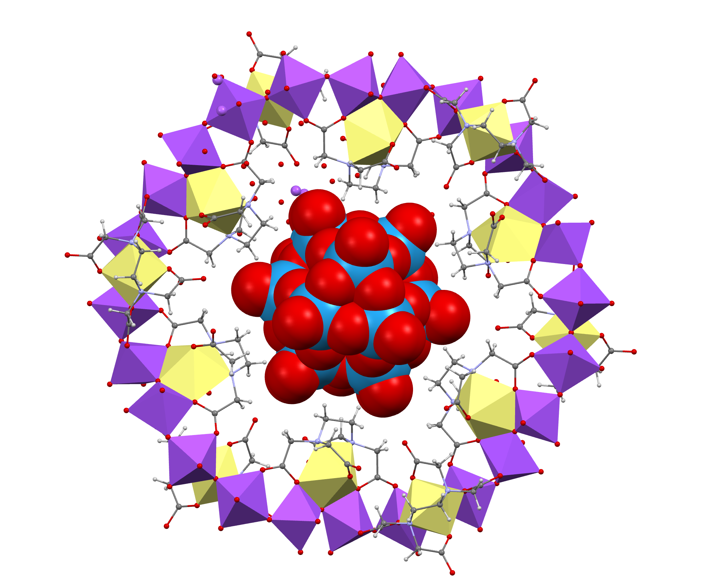
Clare Macrae
C++ >20 years
Chemistry
Approval Tests for C++
Legacy Code, Testing, Refactoring
Clare Macrae Consulting Ltd
clare@claremacrae.co.uk

Slide 8
Inspire
Explore
Experiment
Practice

Slide 9
Themes
Refactoring Tactics
Maximising IDE Help
Safe Changes

Slide 10
From Emily Bache’s Keynote

Slide 11
Refactoring

Slide 12
What is Refactoring?
✅ Restructuring Code
✅ Behaviour Same
❌ Fixing Bugs
❌ Adding Features

Slide 13
The Process
1. See a "Smell"
2. Safe change
3. Test
4. Commit
5. Repeat until done

Slide 14
Yes, But…
What smells?
What safe changes?
When am I done?

Slide 15
Safe, How?
IDE
Tests
Version control

Slide 16
Micro-refactoring
Run Tests
Review Change
Commit
Revert
Fail
Pass

Slide 17
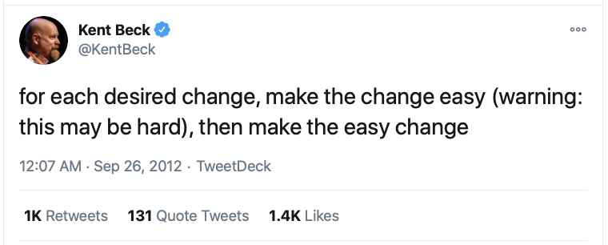
Notes:
https://twitter.com/kentbeck/status/250733358307500032?lang=en

Slide 18
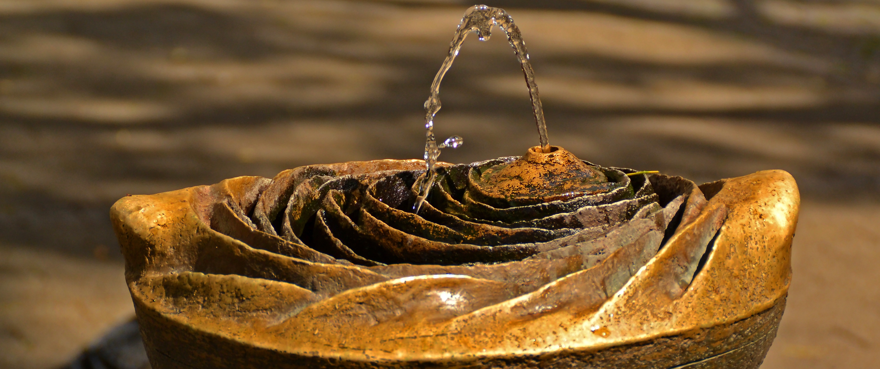
Notes:
Let’s talk about Flow
Image by Uwe Jacobs from Pixabay
https://pixabay.com/photos/fountain-water-jet-gargoyle-260307/
In the zone - focus

Slide 19
Notes:
https://martinfowler.com/books/refactoring.html

Slide 20
Sudoku

Slide 21
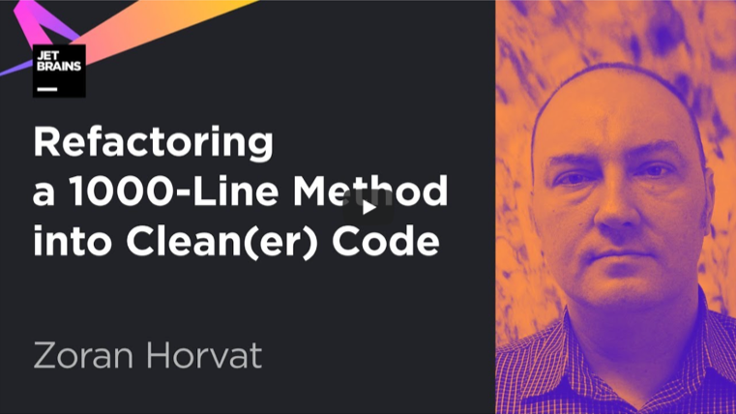
Notes:
https://www.youtube.com/watch?v=9S6qoFZiqCQ
Refactoring a 1000-Line Method into Clean(er) Code

Slide 22
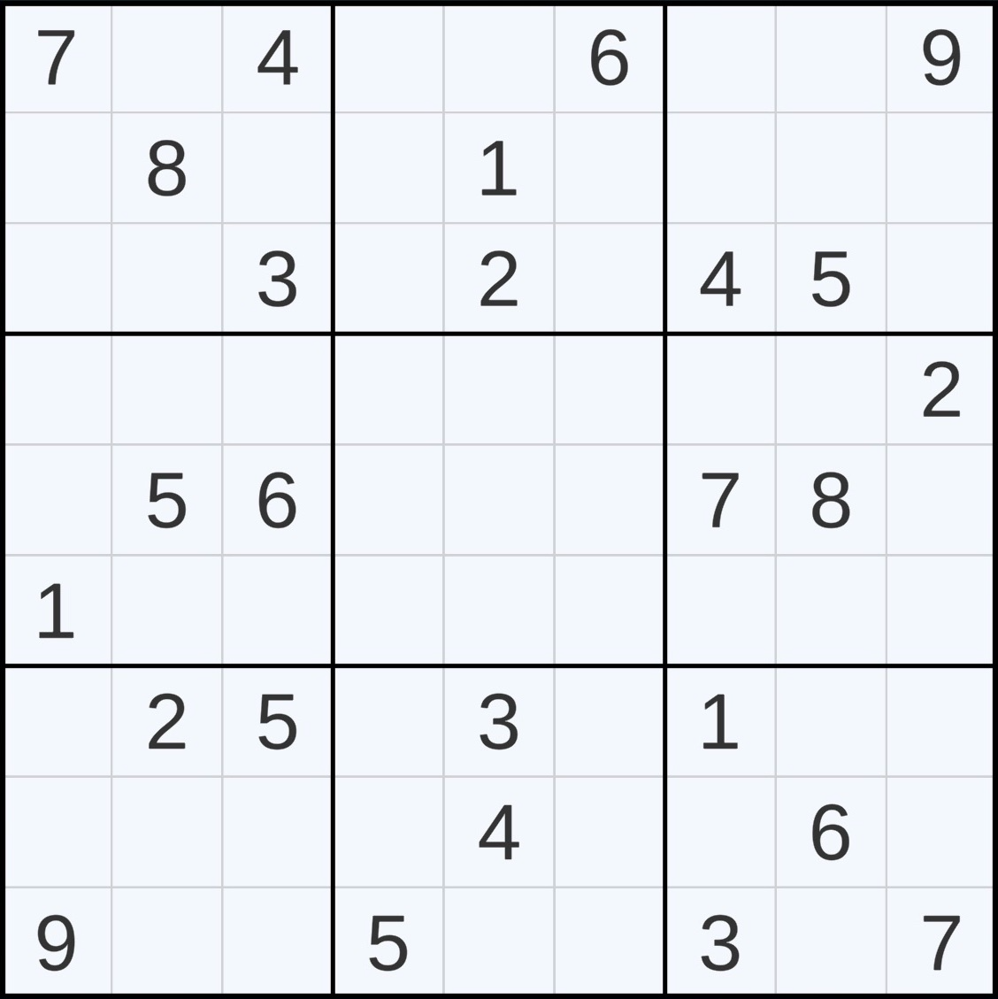
Sudoku Rules
5
Fill the gaps
Digits 1 to 9 once per…
3x3 Box
Row
Column
5
x
x
5
5
x
5
5
5
5
5

Slide 23
Sudoku Kata
Coding practice demonstrating an awfully long method
Try to refactor this 1000-line long method
In C#
github.com/zoran-horvat/sudoku-kata

Slide 24
Step 1
Add Tests

Slide 25
Notes:
Run the program
Add an Approval Test
Deal with random numbers
Coverage

Slide 26
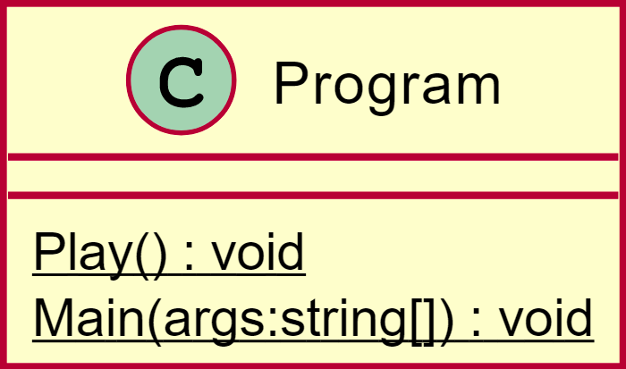
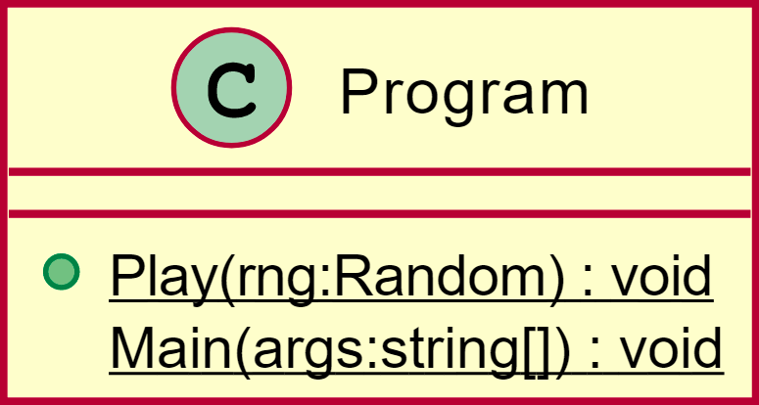
Stable Tests

Slide 28
Avoid the Refactoring Bottomless Pit
Know the Purpose
Particular Bug?
Particular Feature?

Slide 29
Today’s Goal
Solve puzzles set by others

Slide 30
Warning: Don’t be tempted to read the code!

Slide 31
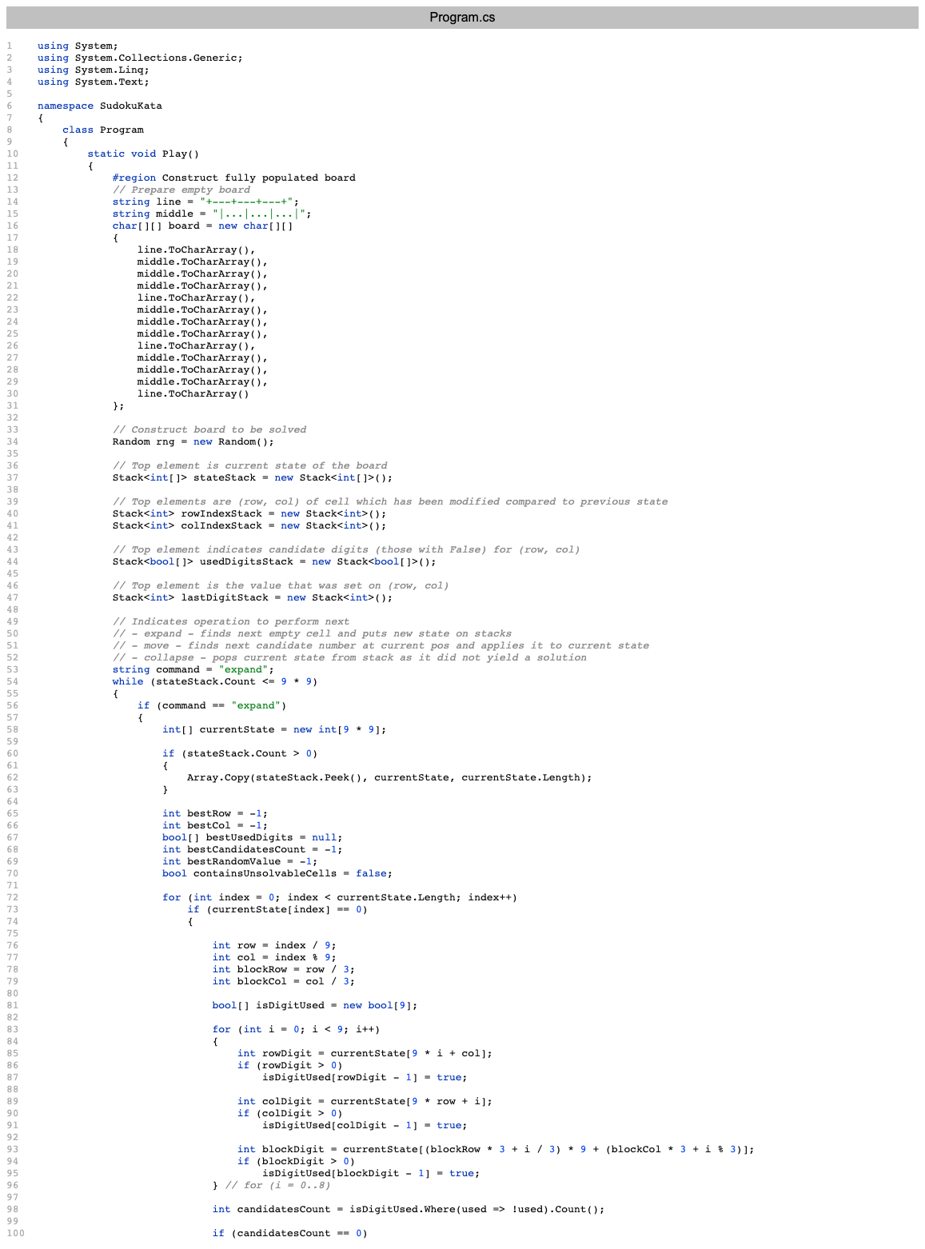
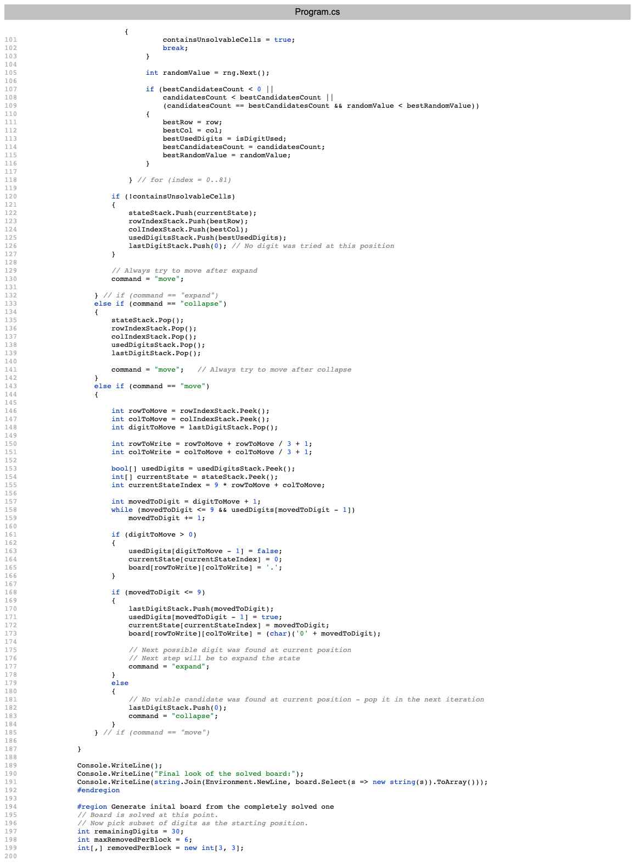
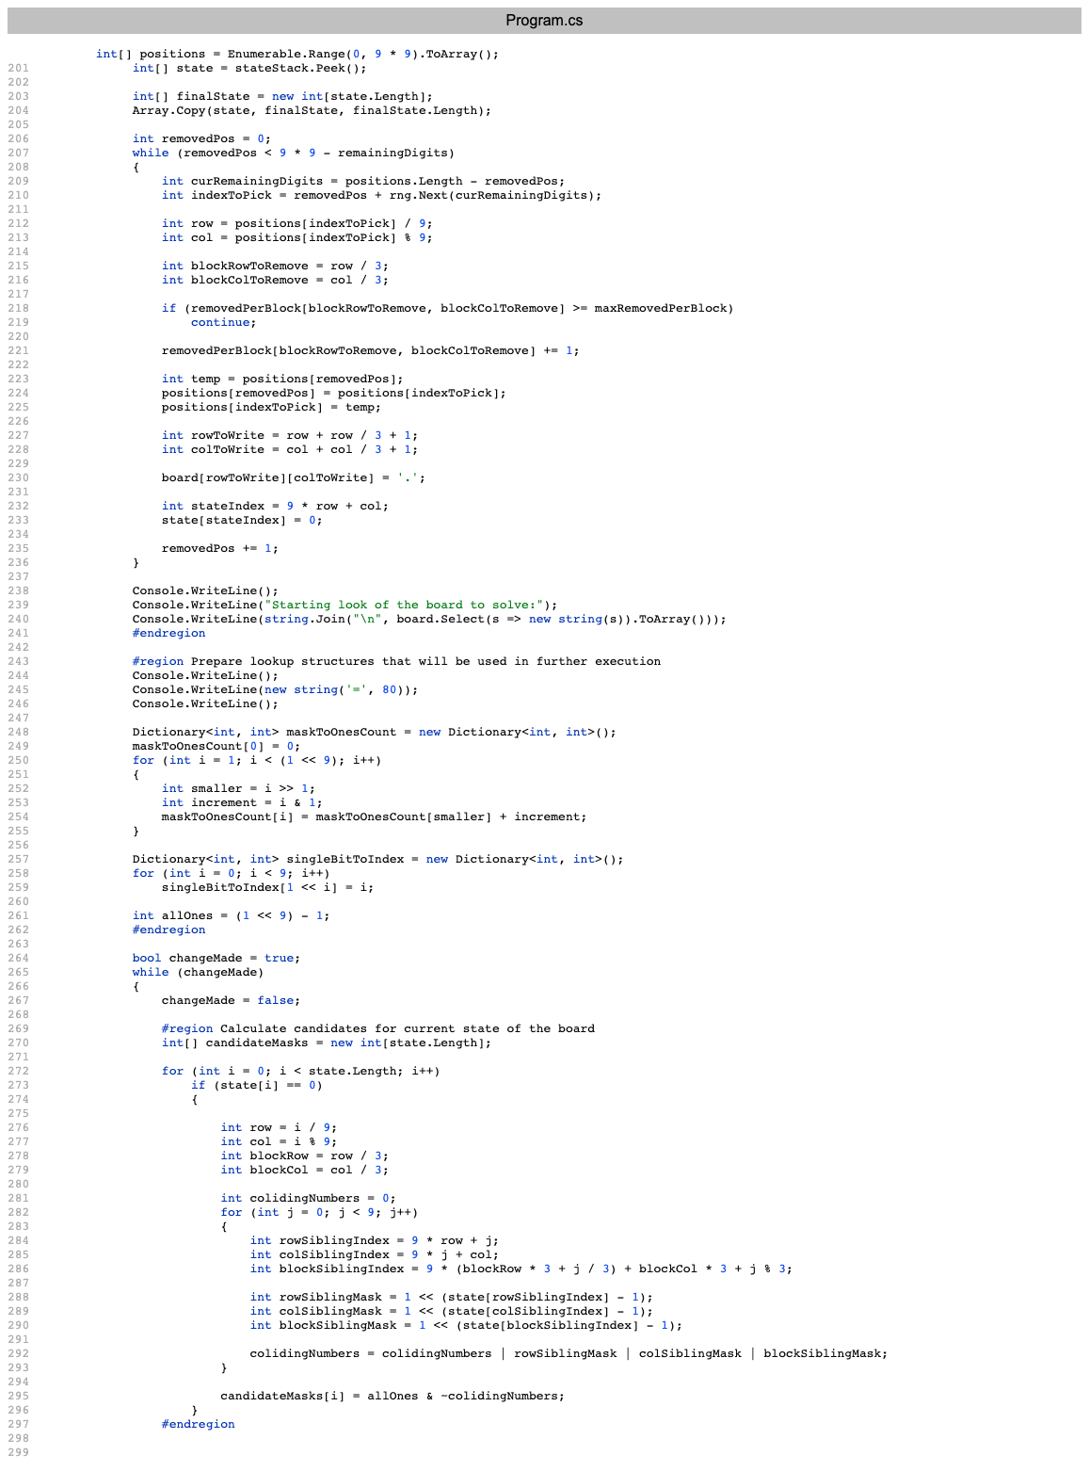
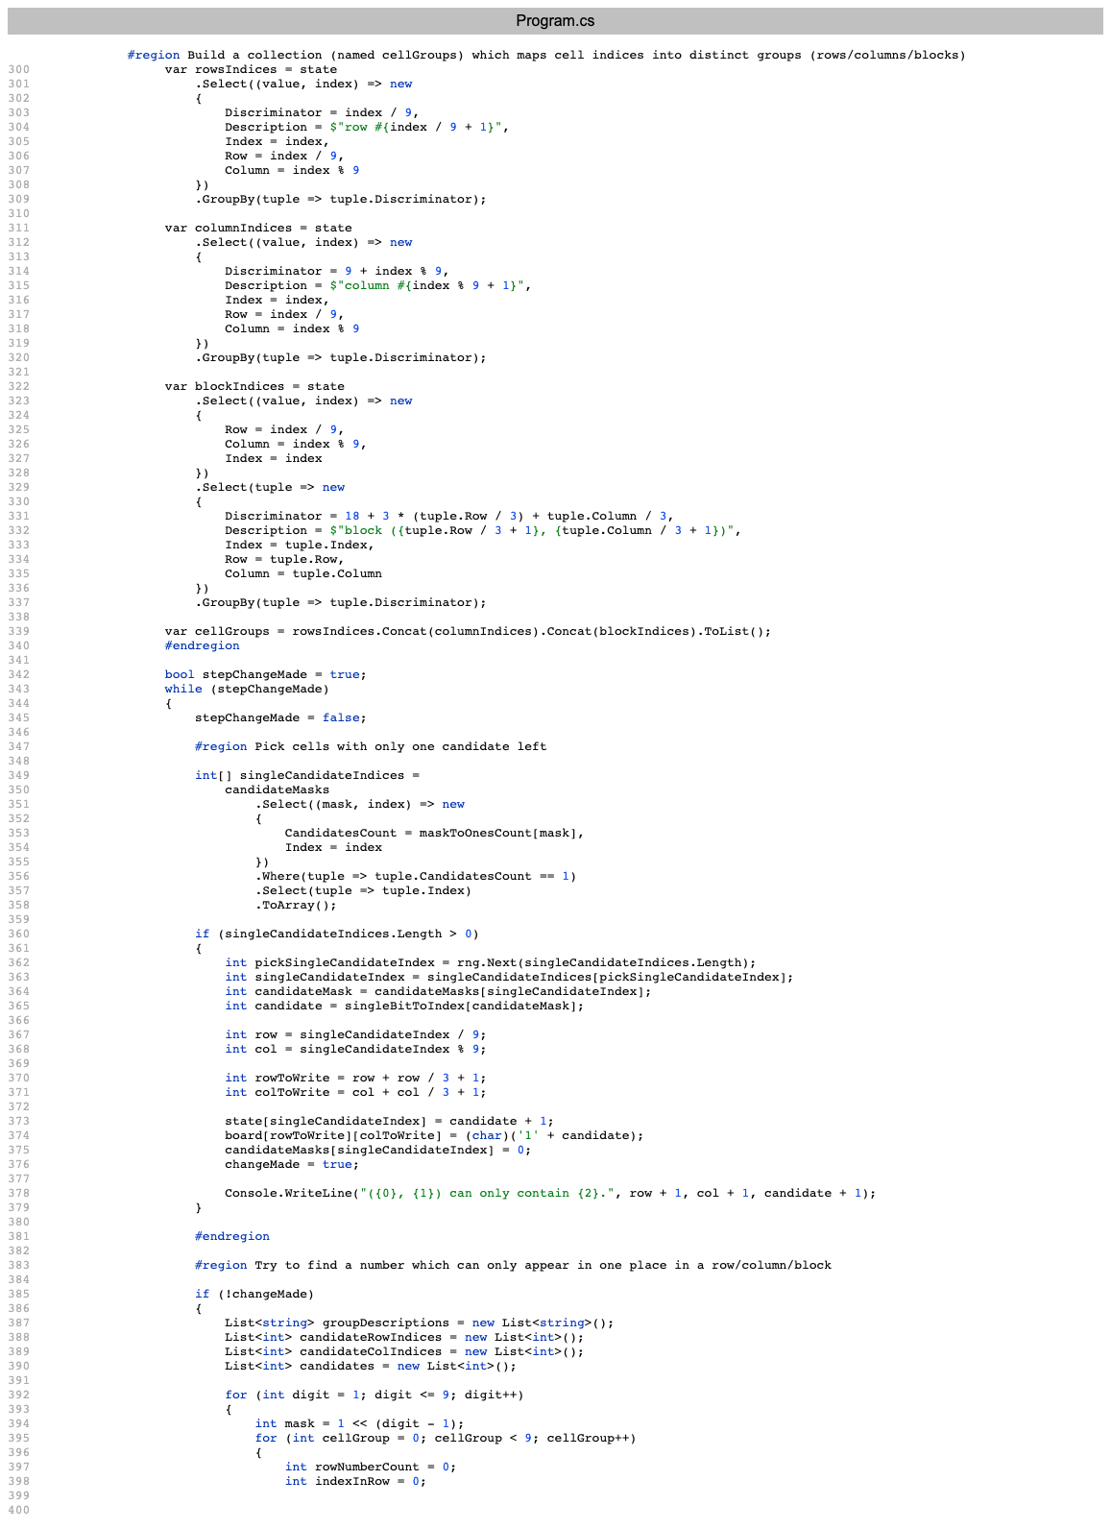
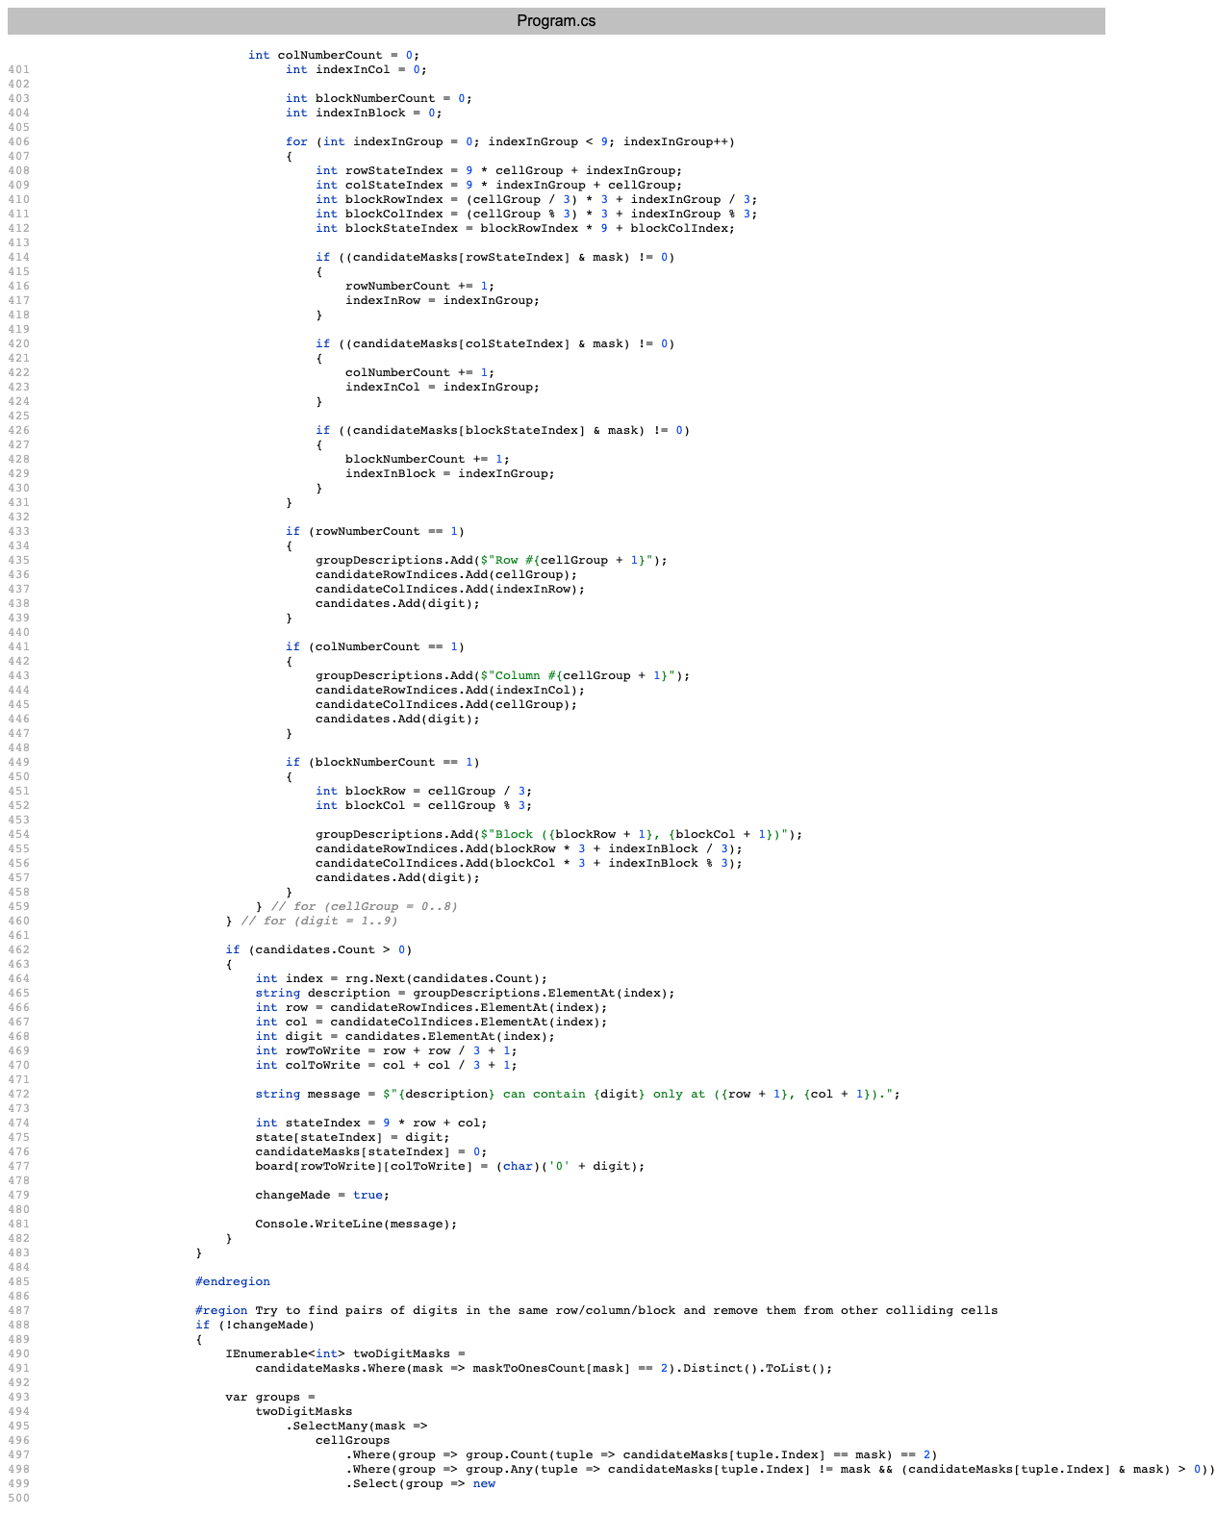
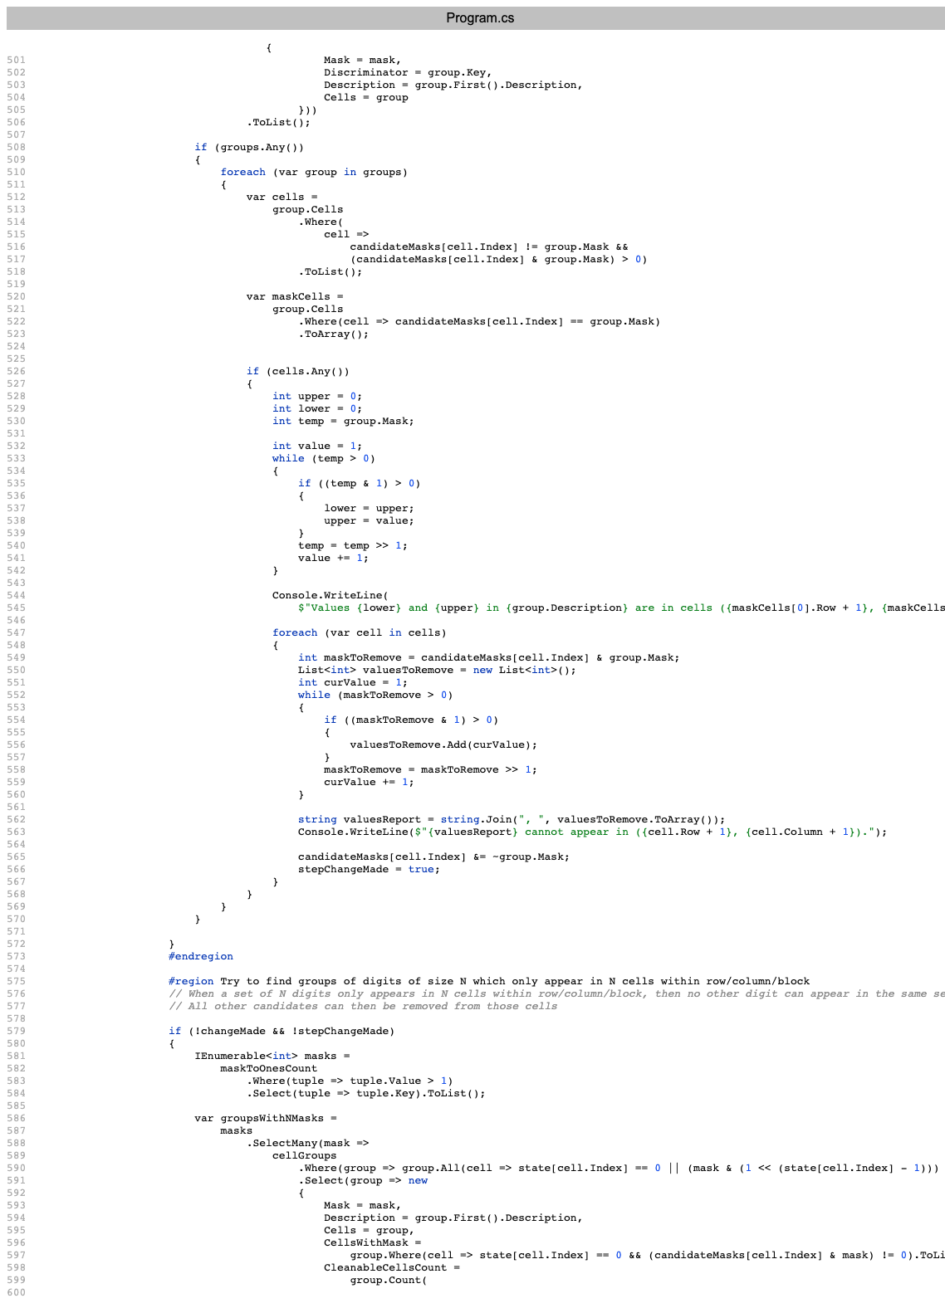
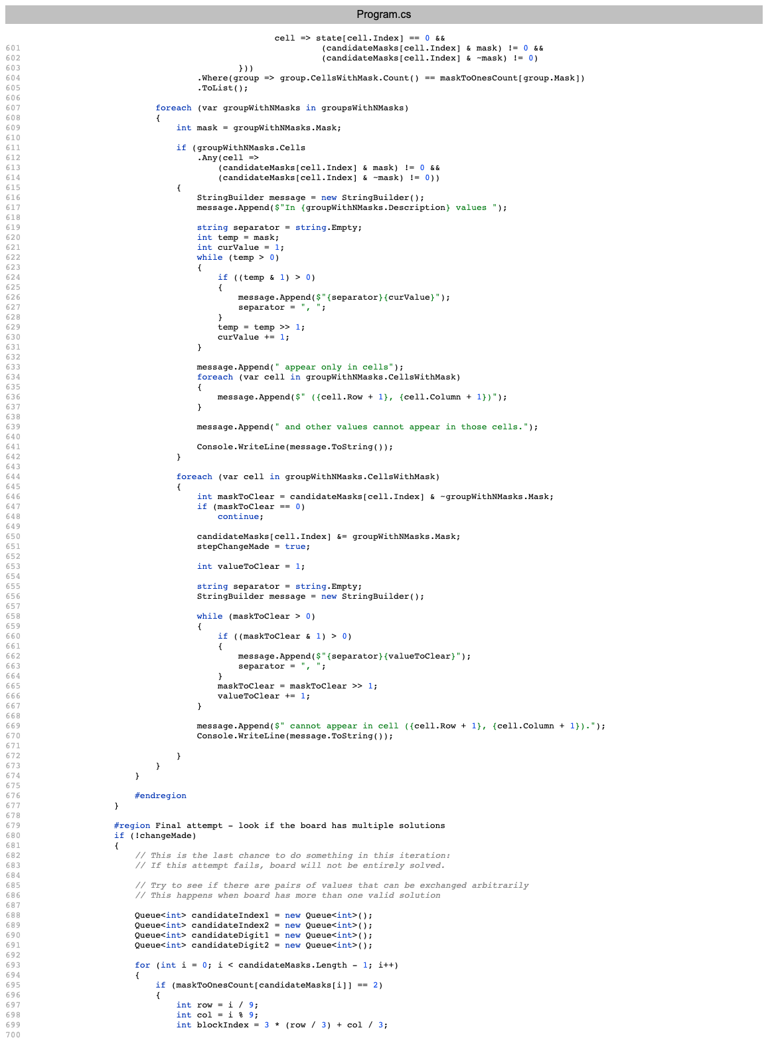
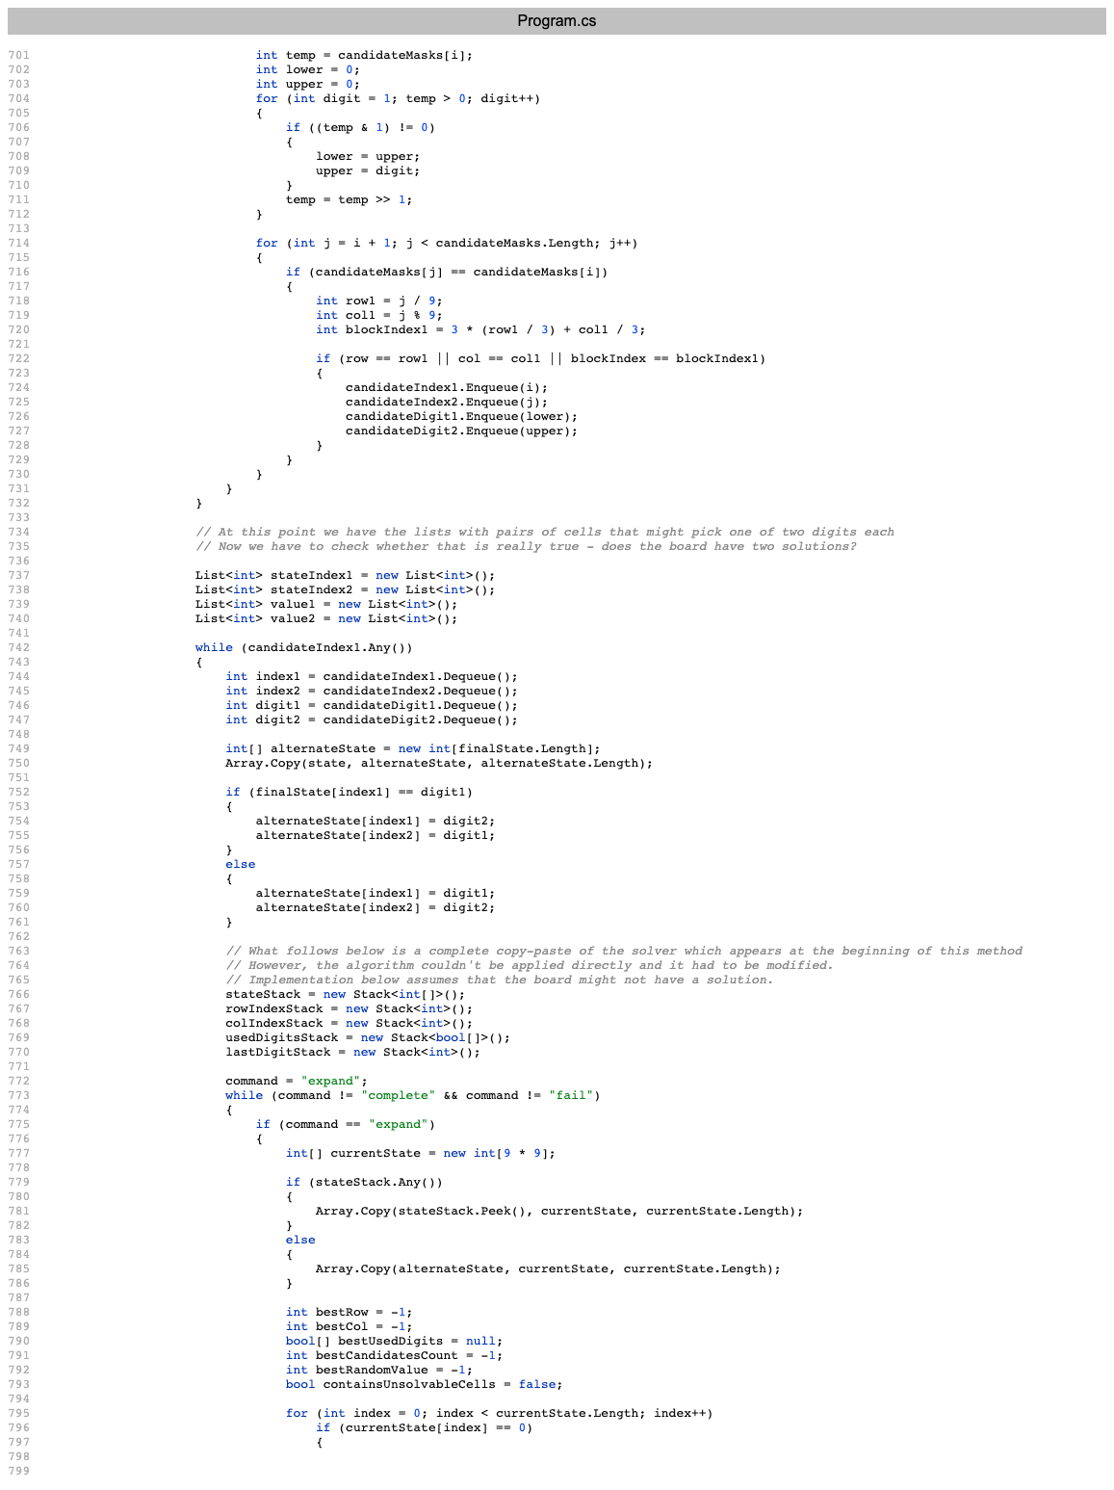
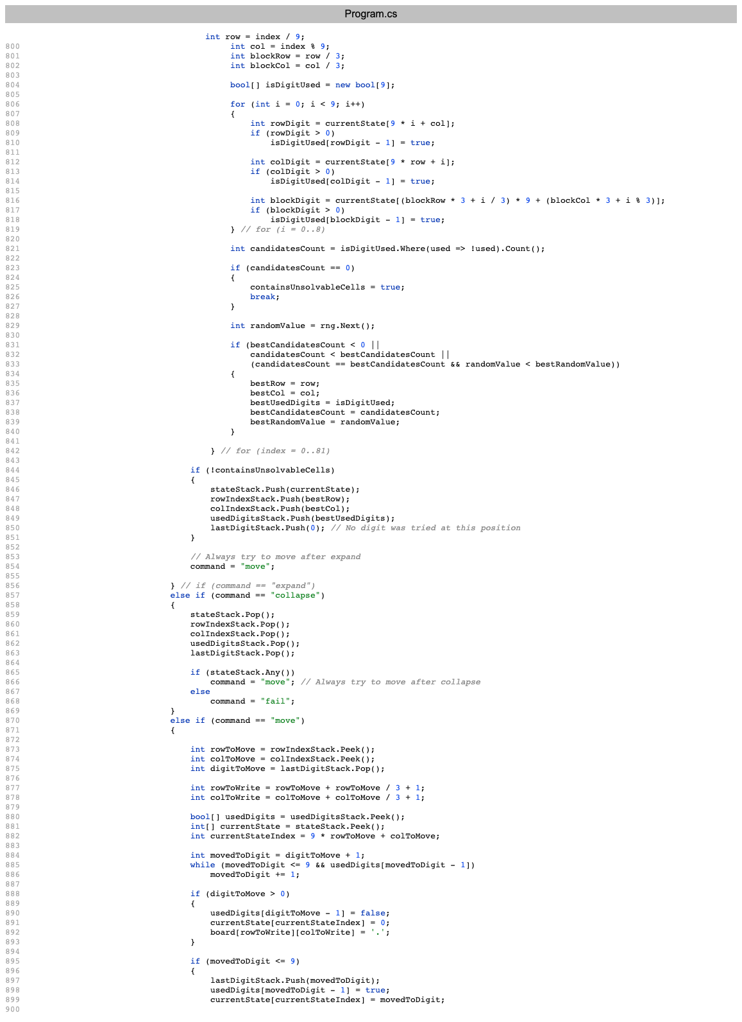
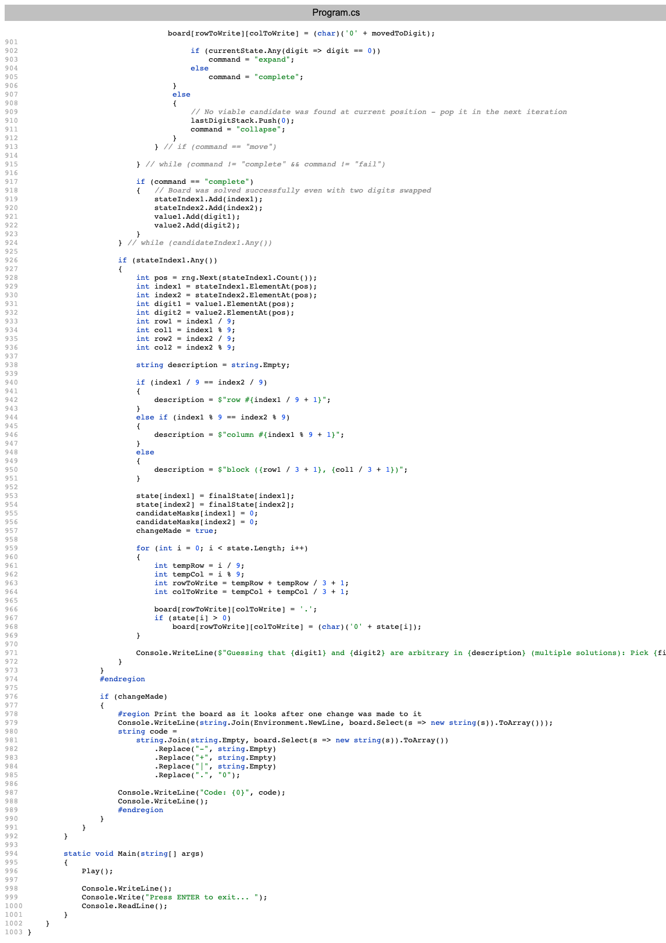
1,004 lines

Slide 32
What to do with long code?
Extract Method

Slide 33
🎦 Extracting Solving Code
Extracting method
Notes:
The console output being verbose is a really good sign – as it becomes useful for capturing the behaviour and making sure we don’t change it.
Suggests that it will protect us by locking the behaviour.
It it wasn’t verbose, we would probably add some logging code.

Slide 34
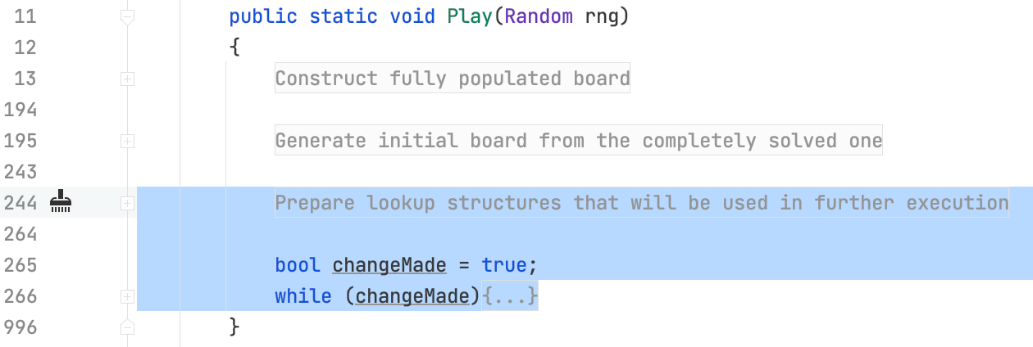
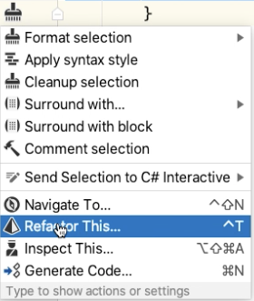

Slide 35
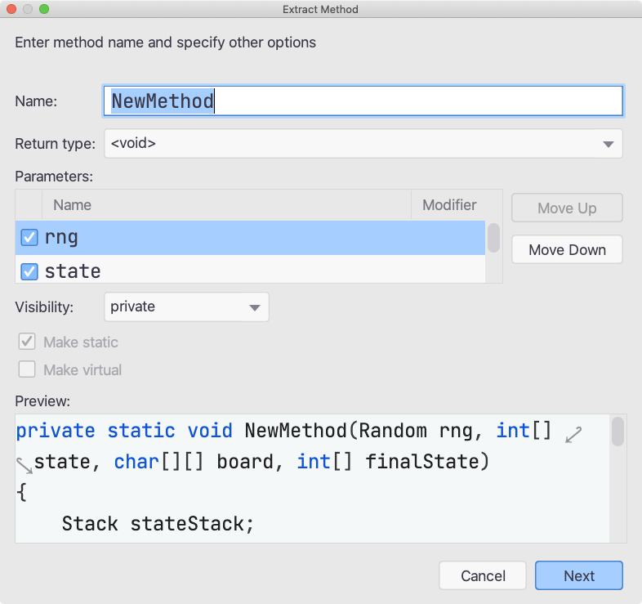

Slide 36
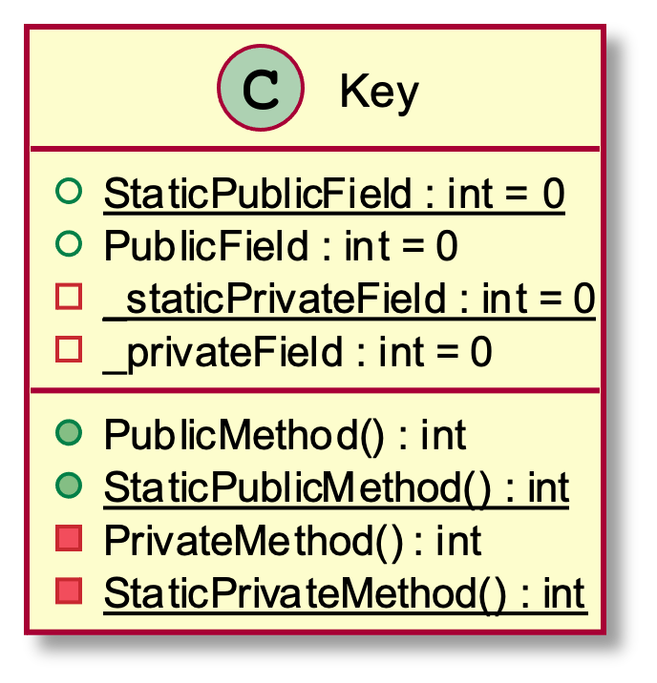
Extract Method

Slide 37
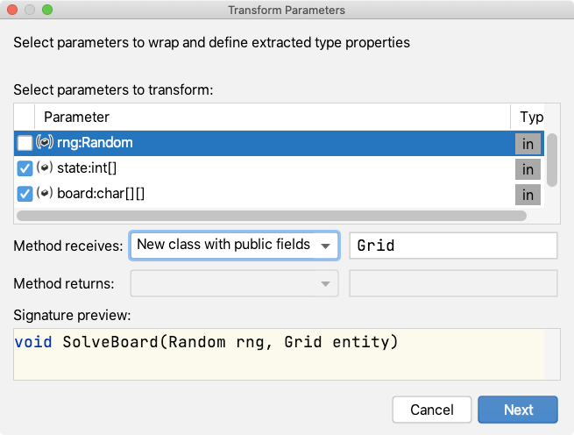

Slide 38
Extract Grid Class
Notes:
Moving towards a better place

Slide 39
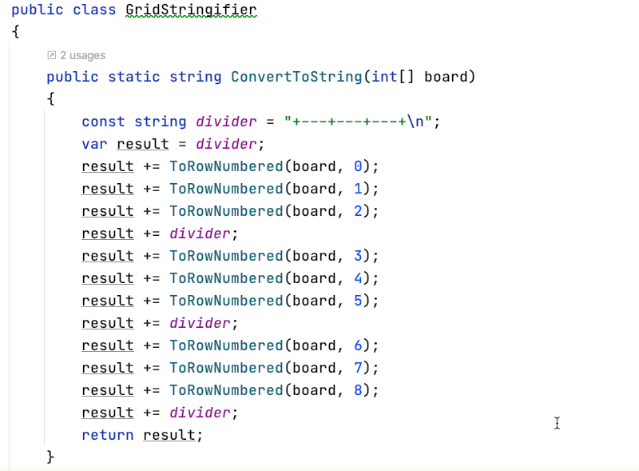
On-demand String Writing

Slide 40
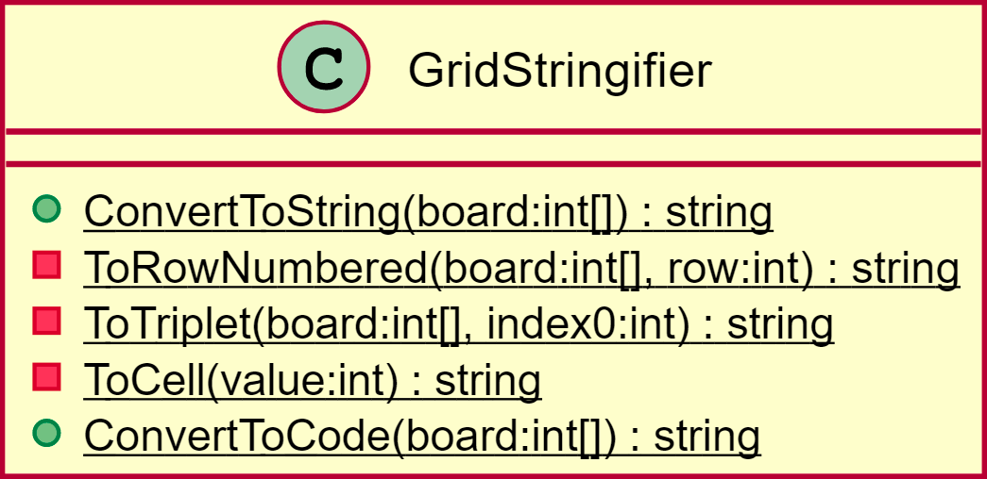
No need to update _board
Notes:
Think of normalising a database – board is a calculated result from state, and now we are making it that way in code

Slide 41
Notes:
https://twitter.com/kentbeck/status/250733358307500032?lang=en

Slide 42
Solving a Grid
Notes:
This is expressive – intent is clear

Slide 43
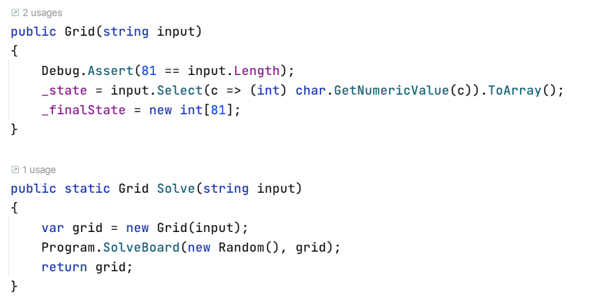
New Feature
Notes:
This is our feature!
Talk about the ROI of this, versus hacking in the feature…
Pays back very quickly, next time I use this code

Slide 44
Was it Worth It?
Was it Worth It?

Slide 45
IDE Abilities

Slide 46
Finding Refactoring in IDE
Cursor location matters!
Many ways to access Refactoring
“Refactoring” in Main Menu
Right-click and “Refactoring”
“Refactor This”
Quick Fix
Generate Code

Slide 47
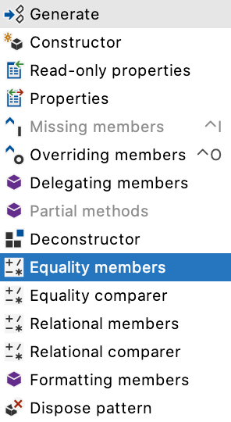
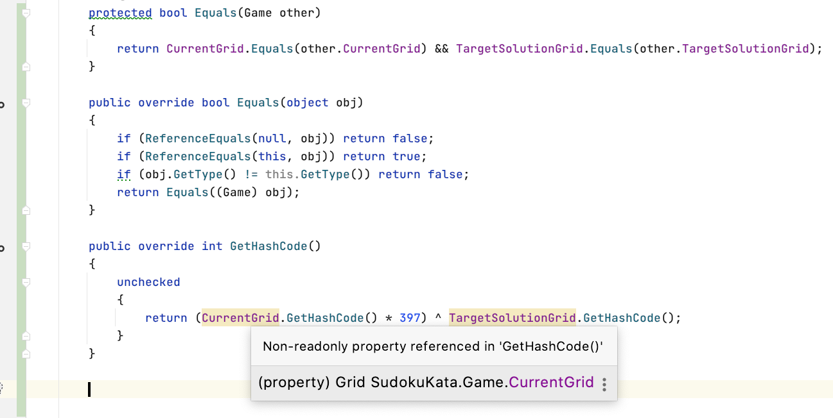
Generate Common Patterns

Slide 48
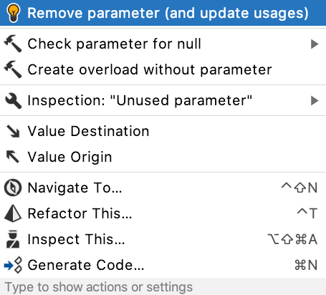
Quick-Fix to Clean Up Code

Slide 49
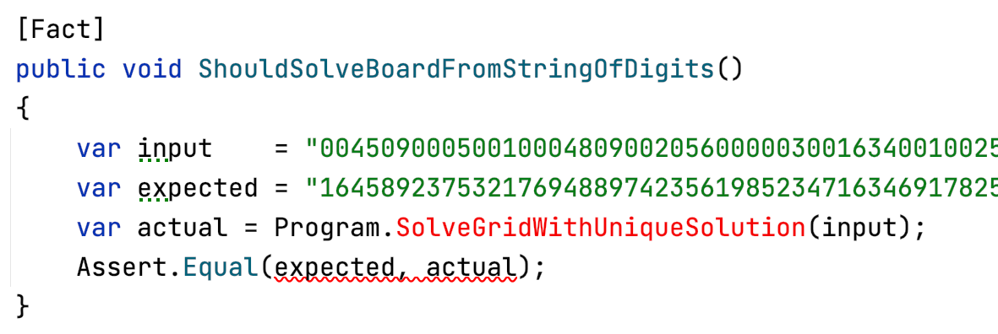
Quick-Fix to Write Your Code
Notes:
If you know the language, it saves you thinking and typing.
If you don’t know the language, it saves you a ton of googling as well.
Lets you take hard-won concepts from one language – and transfer them over to other languages

Slide 50
Your IDE
Language Differ
Development Tools Differ
Experiment!

Slide 51
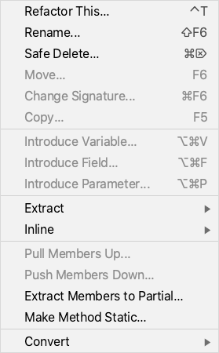
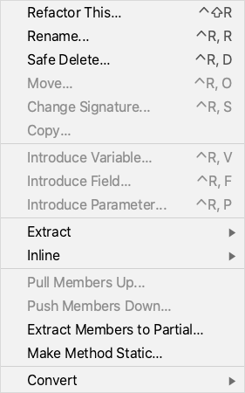
Keyboard Shortcuts
Notes:
Only the V, F and P are memorable

Slide 52
Methods and Functions

Slide 53
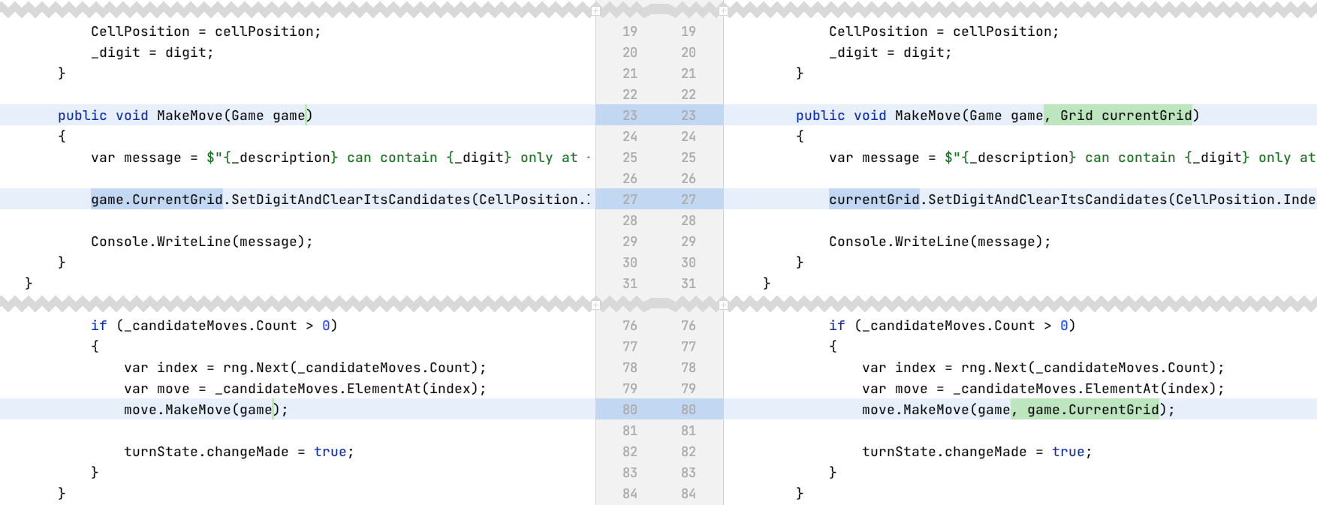
Introduce Parameter
Notes:
https://github.com/claremacrae/sudoku-kata/commit/ed225f2d7da4d1abf68ef3927280000946cb2c72

Slide 54
Remove Unused Parameter
Notes:
https://github.com/claremacrae/sudoku-kata/commit/ca61ac33662d1a3c8bb90c95fe70a1c41e7f087b

Slide 55
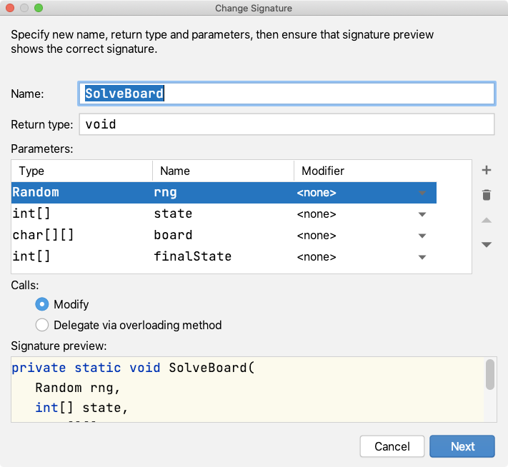
Change Signature

Slide 56
Transform Parameters

Slide 57
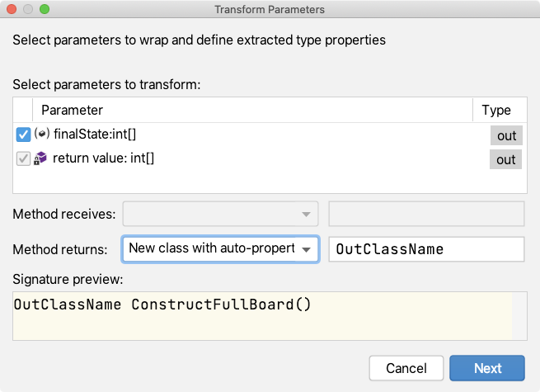
Transform Parameters

Slide 58
Common Abilities
Introduce Parameter
Remove Parameter
Remove Unused Parameter
Change Signature
Transform Parameters
Notes:
Pa

Slide 59
Temptation
Keep moving code around
Keep improving names
Diminishing returns

Slide 60
Adding Abstraction

Slide 61
Finding the Concepts
Class with lots of methods
Want to move related methods together
Moving things that are related closer together
And unrelated, farther apart

Slide 62
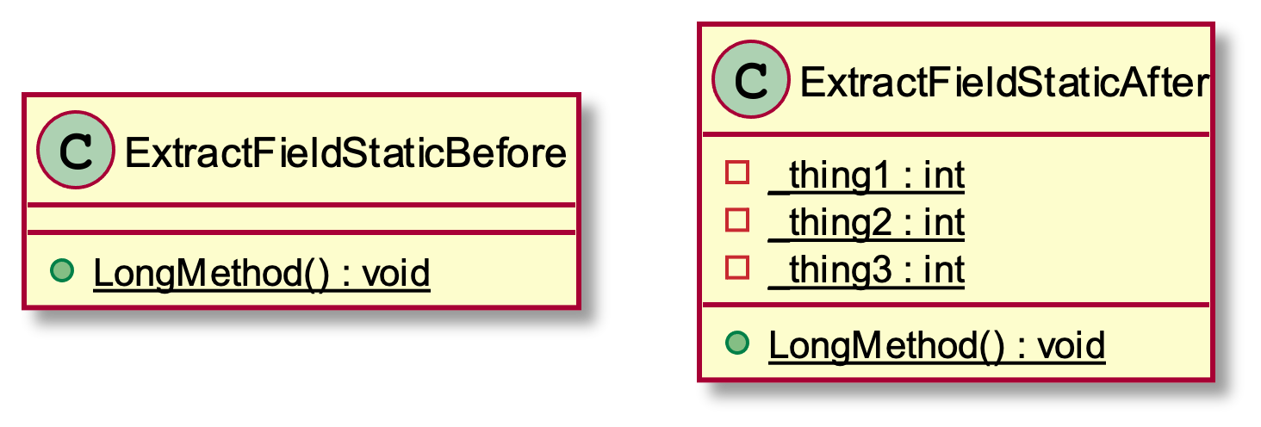
Extract Field

Slide 63
Encapsulate Field

Slide 64
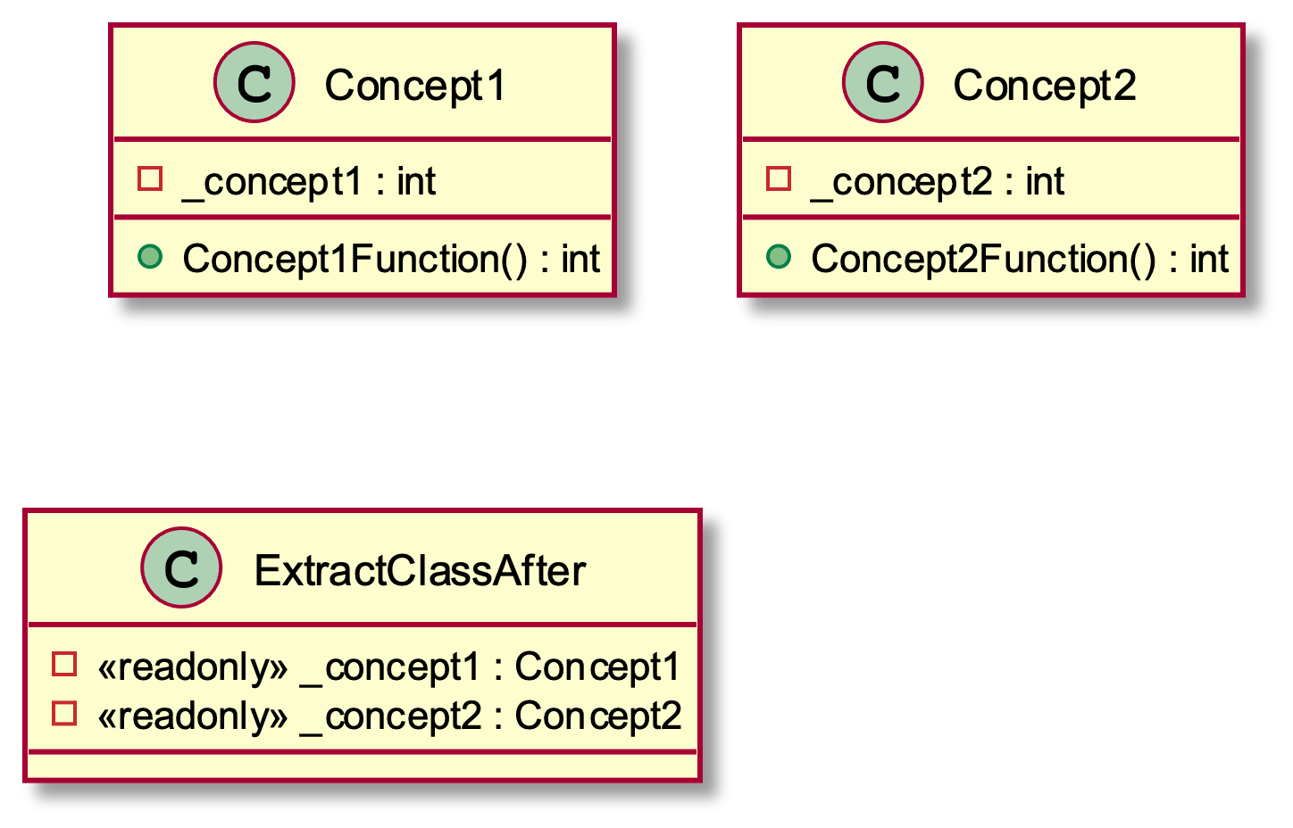
Extract Class

Slide 65
Tips
Really matters whether static or not
Can move methods to
different classes
classes that don’t yet exist
Can take static methods and make them non-static
Notes:
https://twitter.com/KentBeck/status/879411232725389312

Slide 66
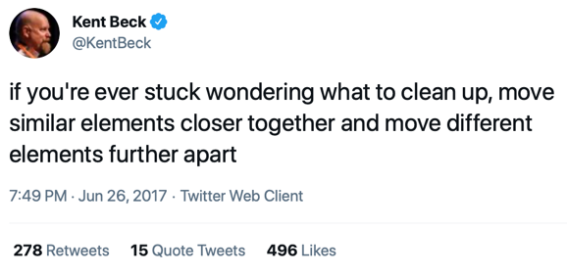
Notes:
https://twitter.com/kentbeck/status/250733358307500032?lang=en

Slide 67
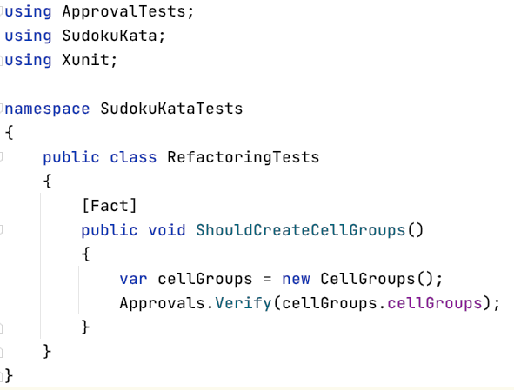
Spot a Pattern

Slide 68
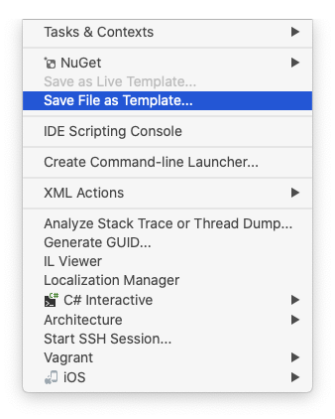
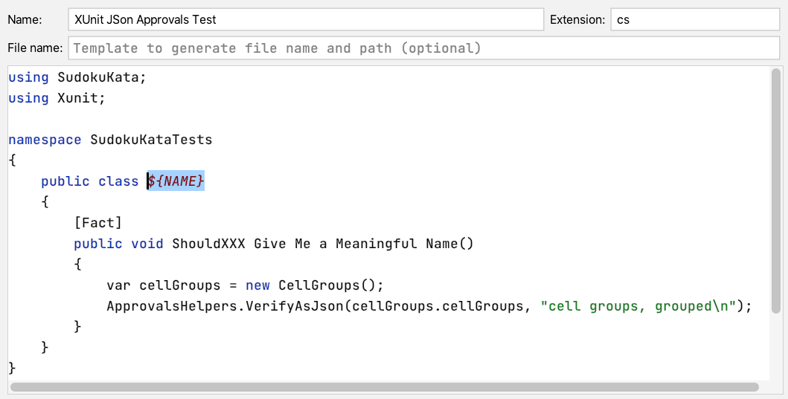
Create a File Template

Slide 69
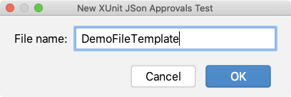
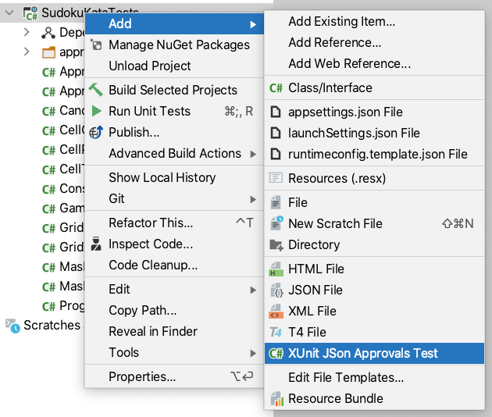
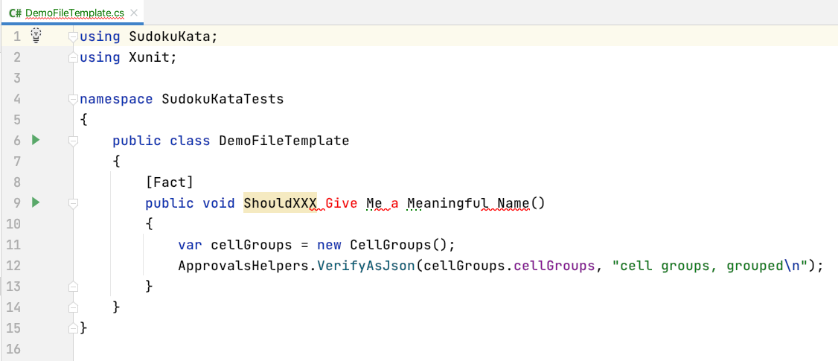
Use the File Template

Slide 70
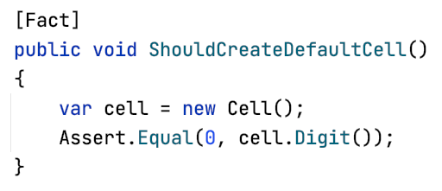
Spot a Pattern

Slide 71
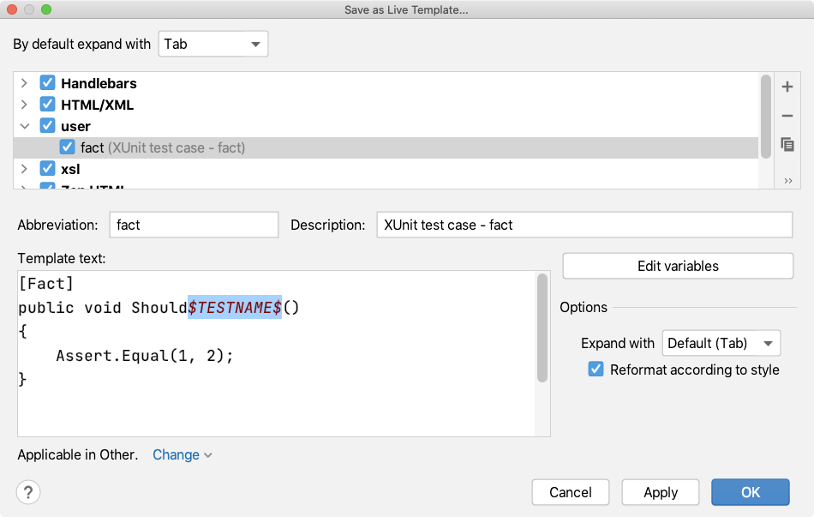
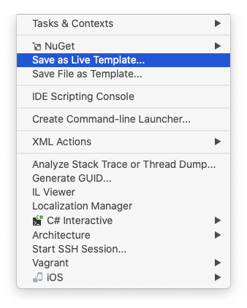
Create a Live Template

Slide 72
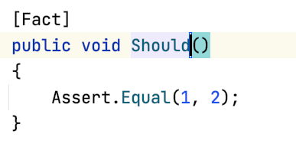
Use the Live Template

Slide 73
Summary: Flow
Practice
Tools help

Slide 74
Conclusions

Slide 75
Benefits
You'll be less tired at the end
Confident that the behaviour is unchanged
Users get the feature sooner

Slide 76
My Message To You!
Explore your IDE’s Auto-Fixes and Refactoring Features
Practice refactoring difficult code
Know how to use Safe Steps to transform the code

Slide 77
Notes:
Let’s talk about Flow
Image by Uwe Jacobs from Pixabay
https://pixabay.com/photos/fountain-water-jet-gargoyle-260307/

Slide 78
Thank You!
@ClareMacraeUK
clare@claremacrae.co.uk

