Slide 1
Unit Testing Beyond Mock Objects
Sven Rosvall
sven@rosvall.ie
ACCU 2014

Slide 2
Agenda
Traditional unit testing and mocking.
Design to interfaces.
3rd party libraries without interfaces?
Use mockable wrappers, for example TimeProvider.
My own example where 3rd party library returns objects with no public constructors.
New generation mocking frameworks

Slide 3
Example: Get current time
Notes:
This is a standard example of a static method. We can only test LunchManager with the time that GetNow() returns. We may have to wait for next day to get a time where IsLunchtime() returns true.

Slide 4
Example: Get current time
Notes:
To allow mocking of the static GetNow() we introduce a TimeProvider with its interface. The interface makes mocking possible. Now we can unit-test LunchManager.

Slide 5
Example2: Manage VMs
Notes:
And now for a more complex example. The Manager class is in a network enabled library. GetVMs() connects to a virtualization system and returns VM objects. The VM objects have a GetName() method which also connects to the virtualization system. We want to mock out these classes to avoid network traffic. But these classes have no interfaces. They may even be declared final/sealed and the VM class may have a non-public constructor.

Slide 6
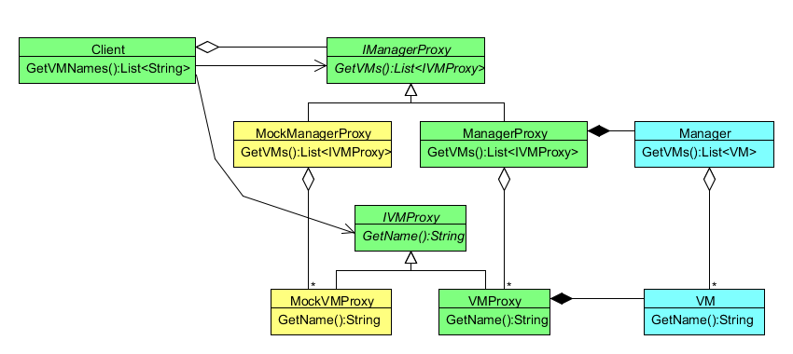
Example2: Manage VMs
Notes:
So we create these proxy classes for the Manager and VM classes and introduce interfaces.
This quickly gets out of hand. There is a performance penalty in the production code, but more importantly, there is a penalty in maintenance of these proxy classes and interfaces.

Slide 7
Mocking Frameworks
Traditional mock frameworks | New mock frameworks
Use reflection | Instrument byte code
Limited to virtual methods. Mocked classes must have interfaces or abstract classes | Mock static, final/sealed classes and static, final methods.
Requires good design “programming against interfaces” | Mocking for legacy libraries.
MoQ, Rhino Mocks | Microsoft Fakes, Typemock Isolator
EasyMock, JMock, Mockito | PowerMock, JMockit

Slide 8
Comparisons
 |  | Mocks | Constraints | Static & Non-virtual methods | Constructors | Concrete classes | Sealed / Final classes | Partial mocks
.Net | MoQ | X | X
 | Typemock | X | X | X | X | X | X | X
 | MS Fakes | X |  | X | X | X | X | X
Java | JMock / EasyMock | X | X
 | Mockito | X | X |  |  | X
 | JMockit | X | X | X | X | X | X | X
 | PowerMock | X | X | X | X | X | X | X

Slide 9
Microsoft Fakes
Comes with Visual Studio 2012.
Provides “Stubs” and “Shims”.
No constraints support
Stubs | Like traditional mocks. Mock objects from interfaces.
Shims | Concrete, final and static classes and methods.
Notes:
Demo in folder FakesExample.

Slide 10
PowerMock
Java Framework
Extensions to EasyMock and Mockito.
Uses custom class loader and bytecode instrumentation.
Notes:
Demo in folder PowerMockExample.

Slide 11
References
.Net
Microsoft Fakes: http://msdn.microsoft.com/en-us/library/hh549175.aspx
Typemock: http://www.typemock.com/
Java
Mockito: http://code.google.com/p/mockito/
PowerMock: http://code.google.com/p/powermock/
JMockit: http://code.google.com/p/jmockit/
http://en.wikipedia.org/wiki/List_of_unit_testing_frameworks
Notes:
The list in Wikipedia is very useful and shows test frameworks for many different purposes.

